Slide 1
Team TRM
Rosemond Fabien, Michael Barnard, Trung Tran, Nikita Buslov

Slide 2
Project Pipeline
Preprocessing
Feature Extraction
Random Forest
CNN

Slide 3
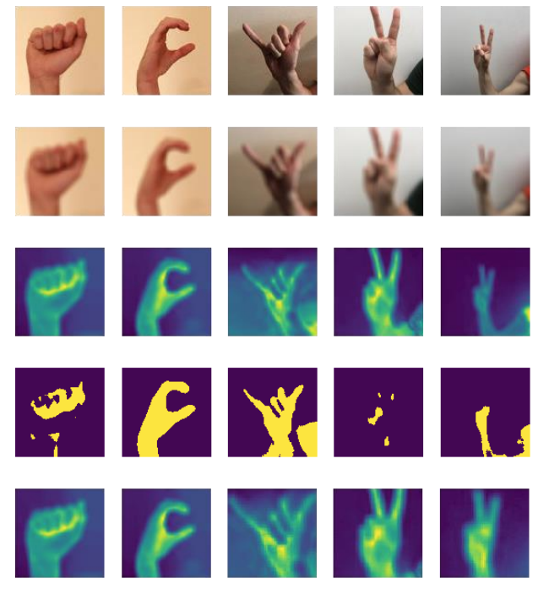
Preprocessing
Initial Image Issues/Inconsistencies:
Rotation
Random objects
Background Color
Hand sizes
Skin Tones
Processing steps - Each row of images to the left is a different step in the preprocess starting with the second row. From top to bottom:
The original RGB images
Apply a box blur of 2
Get Saturation of images
Threshold saturated images
Crop Images

Slide 4
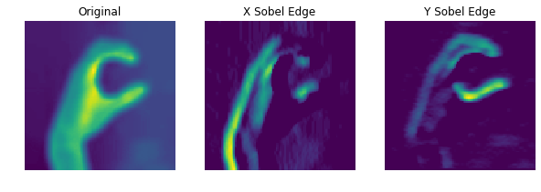
Feature Extraction
Edge Histogram
Gaussian blur to reduce noise in the images
Sobel edge detection in the x and y dimensions to calulate type (horizontal, diagonal, and vertical) and location of the edges
Resulting image is partitioned into 9 equal sections where the x and y edges are averaged and then placed into an 2x9 array
Image: From left to right, that is the original image after preprocessing with an added Gaussian blur to reduce more noise. The following two images are the Sobel edge detection on the x and y dimensions respectively.

Slide 5
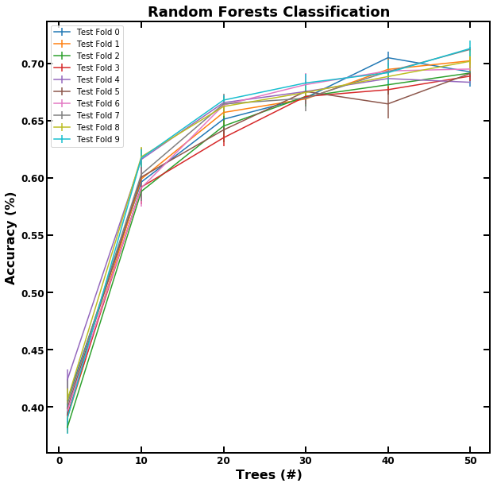
Random Forest Classifier
Quick to implement
Helped visualize results and where we would need to improve.
Gave us direction for the rest of the project.
Approximately 70% accuracy on class’ dataset
Underperformed to desired accuracy,

Slide 6
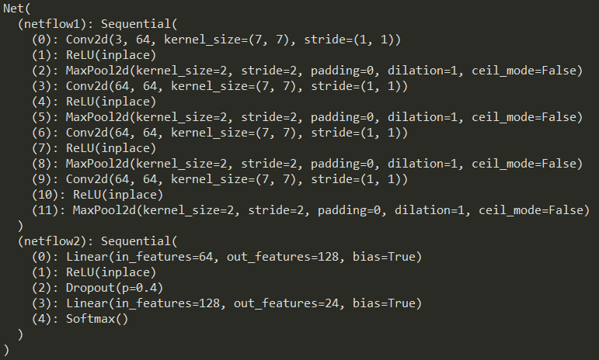
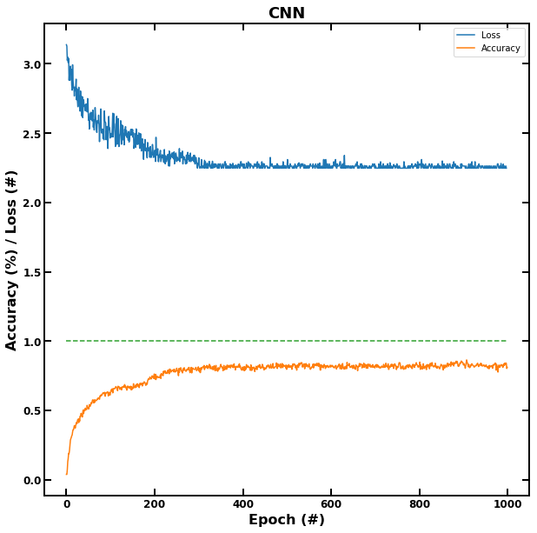
Convolutional Neural Net (from scratch)
4 Convolutional Hidden layers
Trained on MNIST dataset
15 minutes of training on GPU
Accuracy plateaued at 250 Epochs at 0.0001 learning rate
85.5% peak accuracy during validation.
Approximately 70% accuracy during testing.

Slide 7
CNN Training and Preventing Overfitting
With all of the data provided so far, and with a GPU available to speed up training we were only able to obtain an accuracy of 70% with the existing CNN.
From here we needed to find a way to gather more training data, and to apply transformations to our dataset so that would could more confidently train our model and prevent overfitting.

Slide 8
Transfer Learning
Found a Deep Neural Network model made for classification tasks like this.
Challenge came with trying to identify large number of classes with a limited number of features even identifiable to the human eye.
Fine tuned an existing resNet34 model to our needs. We needed to incorporate a large amount of extra data.
Data loader allowed us to use image transformation to grow dataset by 5x.

Slide 9
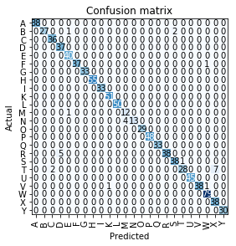
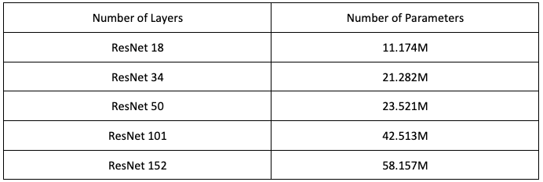
Resnet34 based CNN:
Resnet models addresses the issues of vanishing gradient.
Dataloader addresses issue of overfitting.
Deep and wide network provided many tunable parameters to cater the network to this application.
88% Accuracy on test set from class’ data.
30 minutes of training on GPU

Slide 10
Summary
Method | Large set of tunable parameters | Addressed Overfitting | Accuracy
Random Forest | No | No | ~70%
CNN from scratch | Yes | No | ~70%
Resnet34 CNN | Yes | Yes | ~88%

